Slide 1

species-distribution-model
Explore lepidoptera species around the globe. Goal of the project is to help users become better naturalists.
This project maps lepidoptera species occurrences over time and provides anki deck to help with learning butterfly identification.
Github

Slide 2
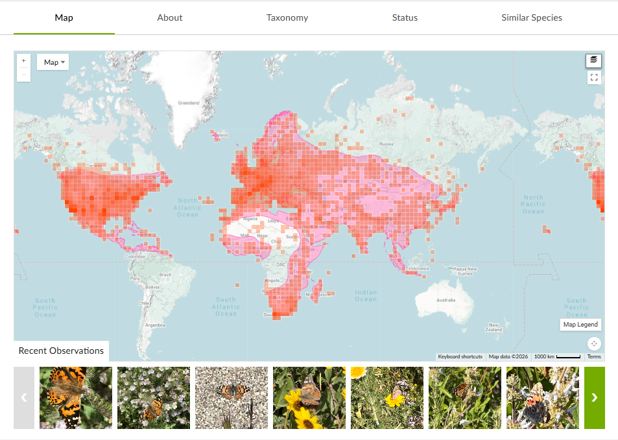
Inaturalist+
Adds functionality to embeded map
- predator occurrences
- native native host plant
- food sources,
- species distribution models**
- animated occurrences over time
Adds dark mode to the site
Adds additional links related to species
-wikipedia
- butterflies of north america BAMONA, LepIndex etc
-
Inaturalist’s default map layer, contains a occurrence density map, not a species-distribution model

Slide 3
Meeting Proposal: Basics to GIS
Learning Objectives
How to make basic visualizations and simple operations using QGIS (open source)
Where to get GIS data from
How is GIS useful?

Slide 4

Thank you, DenHack!
This project would have been significantly more difficult without the computing power provided hosted by the club.
If interested in access to AI-Computer science club’s proxmox server! Please contact codezero or ___ on slack server.

